Slide 1
MONASH
Software Engineering
FIT5136 Software Engineering
Team 48
Haorong Ren
Manyan Wen
Mihir Bhanushali
Xiaohui Ding

Slide 2
For the complete and clear prototype, check the link here:
https://lucid.app/lucidchart/invitations/accept/b64f9e31-f632-42cc-90d7-208fe1fa8308

Slide 3
Explain the UI screens

Slide 4
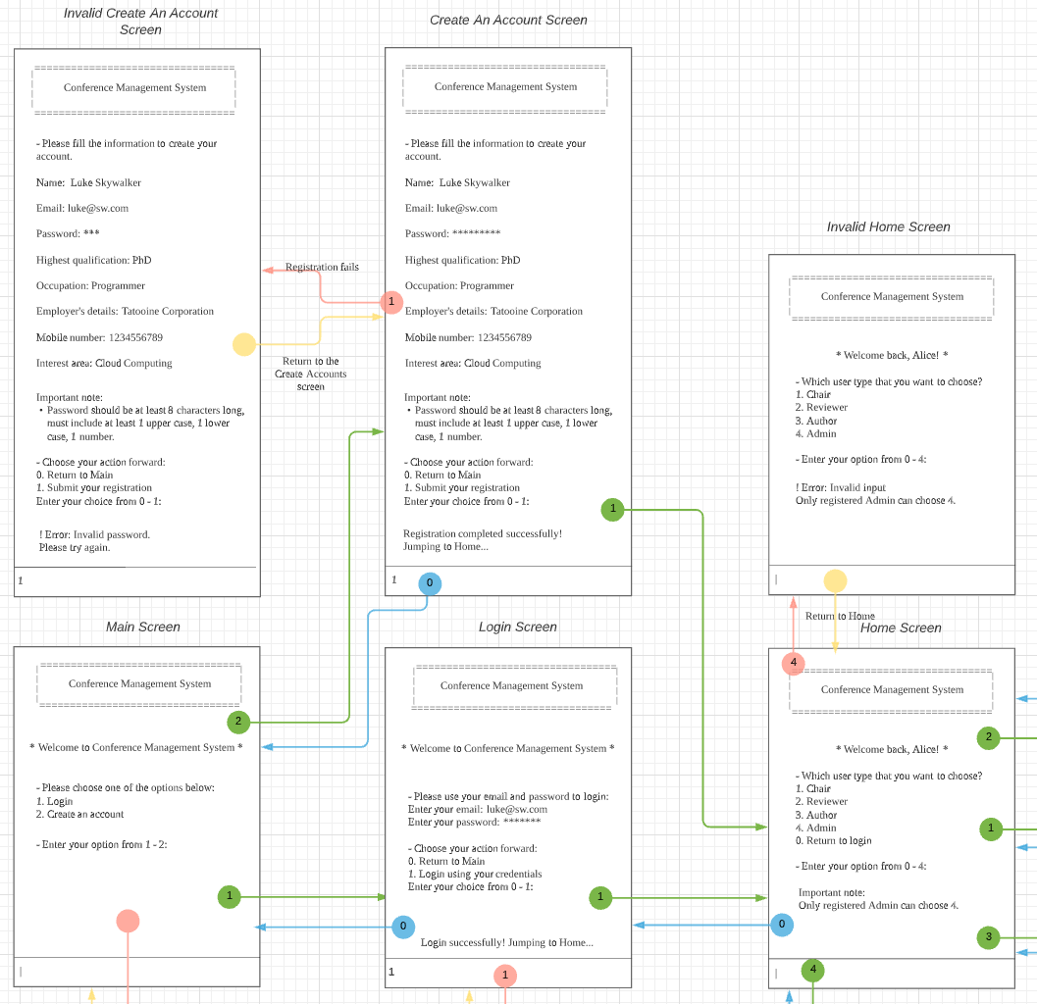
Explain the UI screens
Feature 1: User Registration
Related Screens:
[1] Main Screen
[2] Invalid Main Screen
[3] Login Screen
[4] Invalid Login Screen
[5] Create An Account Screen
[6] Invalid Create An Account Screen
[7] Home Screen
[8] Invalid Home Screen

Slide 5
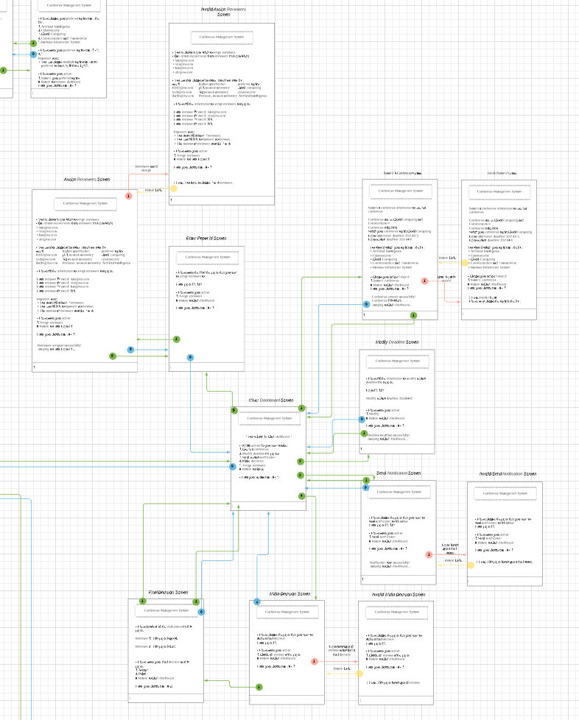
Explain the UI screens
Feature 2: Conference Management
Related Screens:
[9] Chair Dashboard Screen
[10] Submit A Conference Screen
[11] Invalid Submit A Conference Screen
[12] Modify Deadline Screen
[13] Send Notification Screen
[14] Invalid Send Notification Screen
[15] Make Decision Screen
[16] Final Decision Screen
[17] Invalid Make Decision Screen
[18] Enter Paper Id Screen
[19] Assign Reviewers Screen
[20] Invalid Assign Reviewers Screen

Slide 6
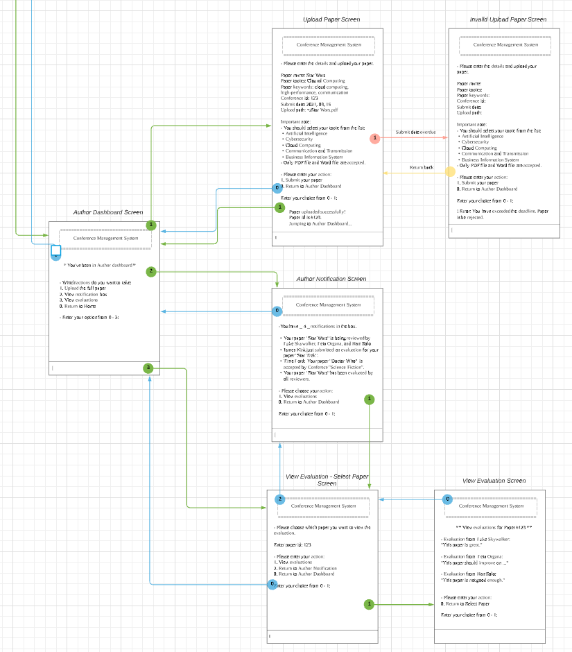
Explain the UI screens
Feature 3: Paper Submission
Related Screens:
[21] Author Dashboard Screen
[22] Upload Paper Screen
[23] Invalid Upload Paper Screen
[24] Author Notification Screen
[25] View Evaluation - Select Paper Screen
[26] View Evaluation Screen

Slide 7
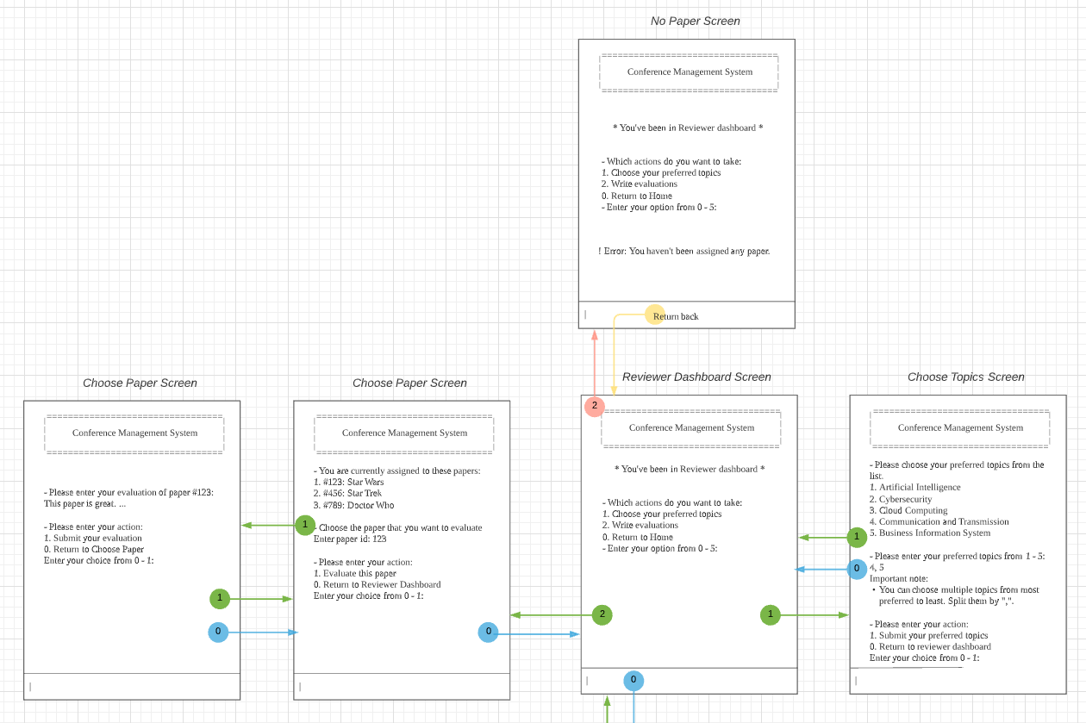
Explain the UI screens
Feature 4: Review Management
Related Screens:
[27] Reviewer Dashboard Screen
[28] Invalid Reviewer Dashboard Screen
[29] Choose Topics Screen
[30] Choose Paper Screen
[31] Write Evaluation Screen

Slide 8
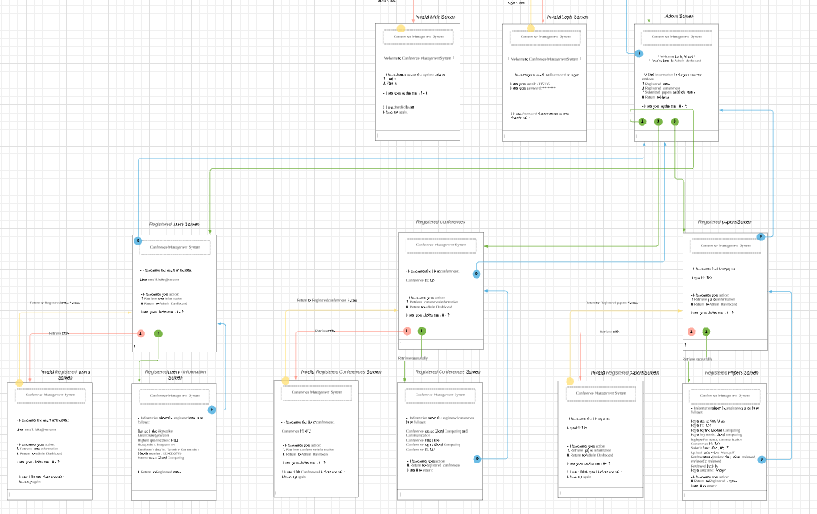
Explain the UI screens
Feature 5: Conference Administration
Related Screens:
[32] Admin Screen
[33] Registered Users Screen
[34] Registered Users - Information Screen
[35] Invalid Registered Users Screen
[36] Registered Conferences Screen
[37] Registered Conferences - Information Screen
[38] Invalid Registered Conferences Screen
[39] Registered Papers Screen
[40] Registered Papers - Information Screen
[41] Invalid Registered Papers Screen

Slide 9
Flow of the events of the application

Slide 10
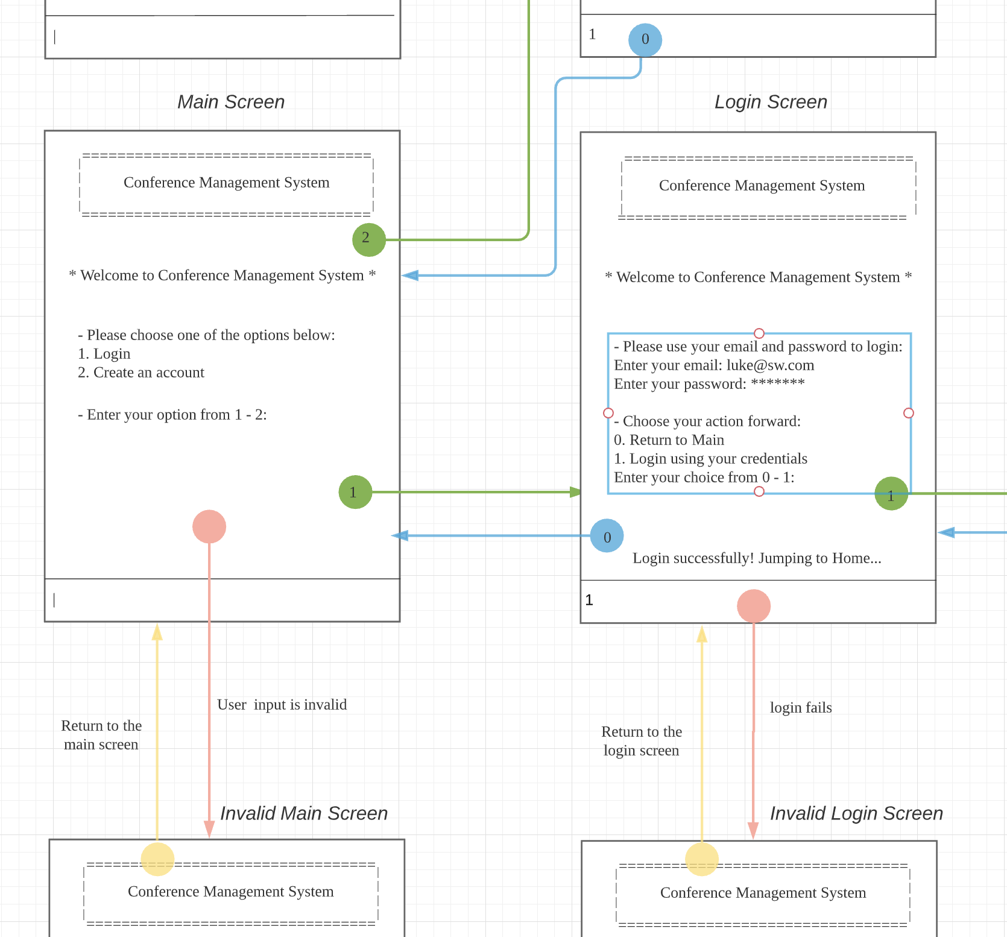
Flow of the events of the application
Green: enter the appropriate option to jump to the next level of the screen
Blue: usually used to return to the previous level of the screen
Red: because of the invalid input, back the screen with an add error message
Yellow: return from the screen with an add error message to the original screen
Number: represent the number on the corresponding option

Slide 11
Usability Design Principles
Ben Shneiderman’s 8 Golden Rules

Slide 12
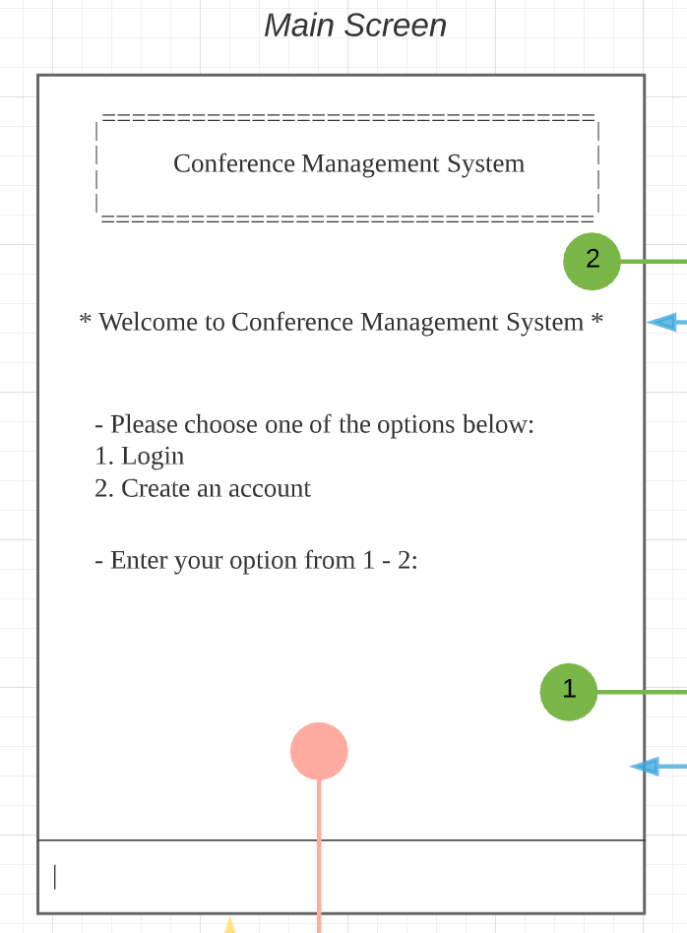
Usability Design Principles
1: Strive for consistency
Conference Management System box
We have this title box on the top for all screens to maintain the consistency.
Flow
As previously introduced, our flow and flow number all maintain the consistency.
Input box
We have this input box in the bottom for all screens to maintain the consistency.

Slide 13
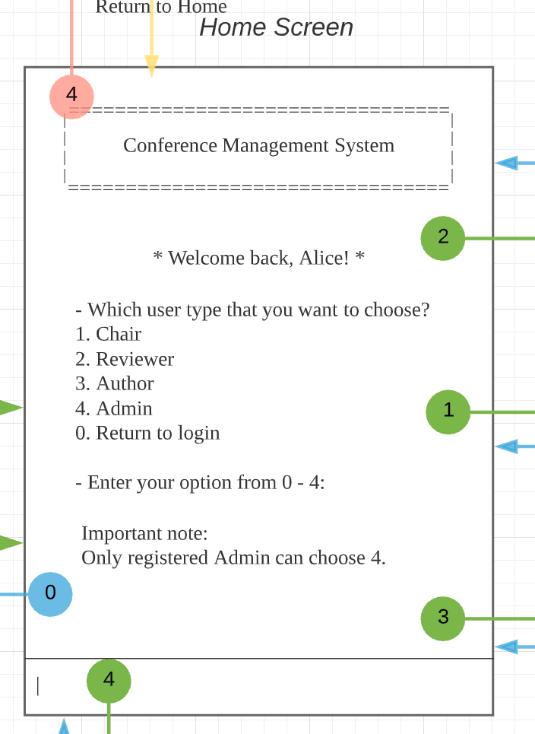
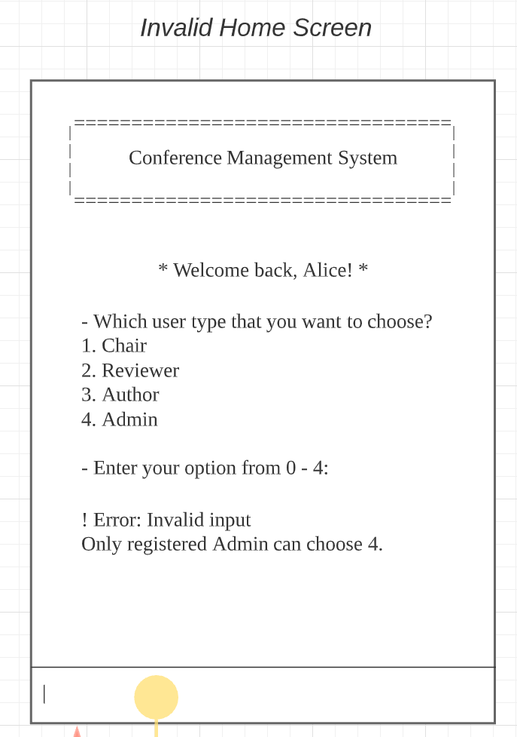
Usability Design Principles
2: Cater to universal usability
False option feedback
Only registered Admin can use features of Admin, but some users don’t know that. So, for catering to universal usability, we add these text and false option feedback to help.

Slide 14
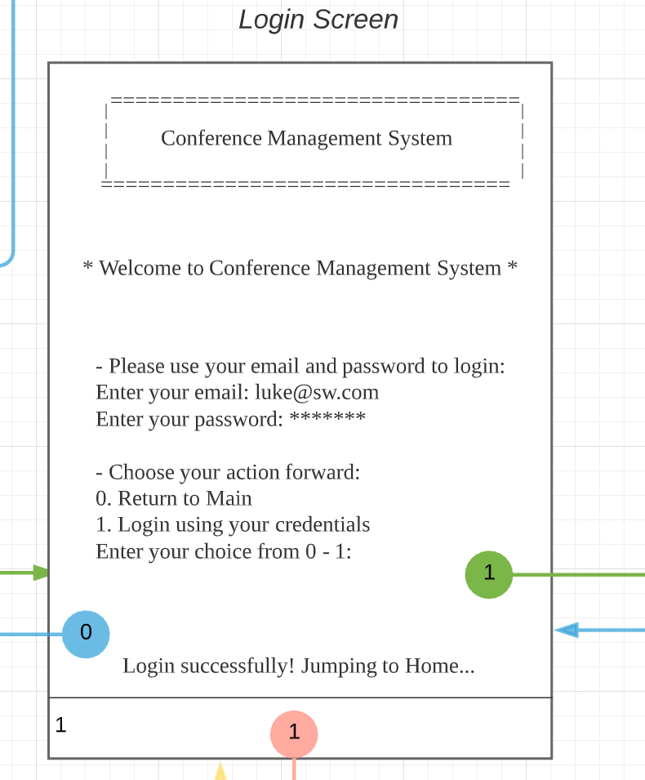
Usability Design Principles
3: Offer informative feedback & 4: Design dialogs to yield closure
Action forward
When the system executes the action that users choose, there is an informative feedback.
This is also a response/closure to the login request.

Slide 15
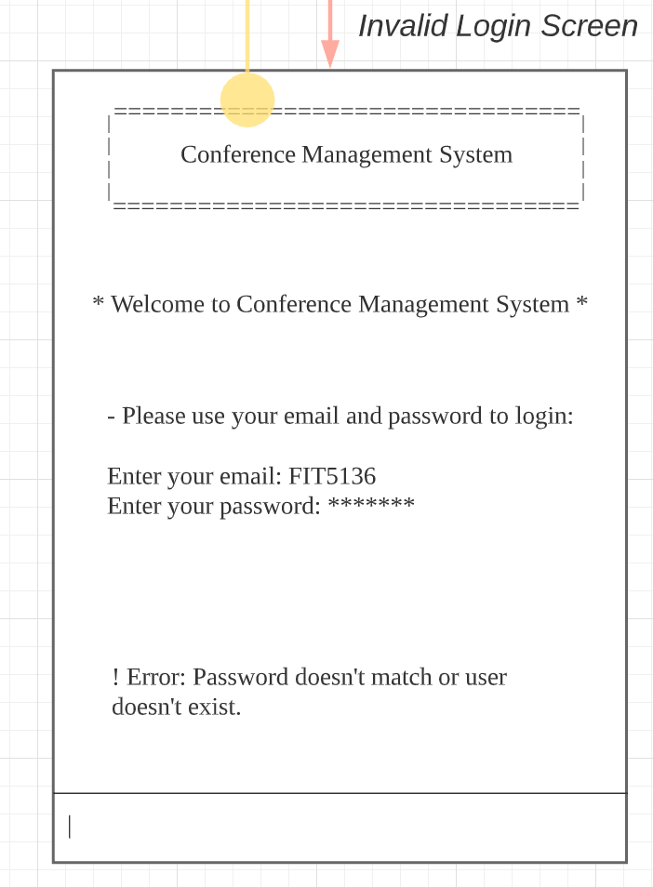
Usability Design Principles
5: Prevent errors
Invalidation check
We added many invalidation check for the user inputs to prevent potential errors.

Slide 16
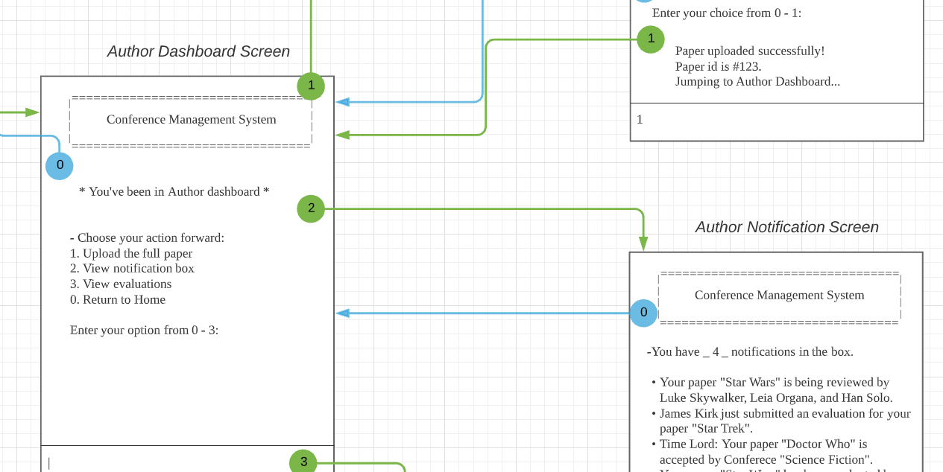
Usability Design Principles
6: Permit easy reversal of actions
Reversal of actions
We added many reversal of actions to help users find a way to return to the previous screens

Slide 17
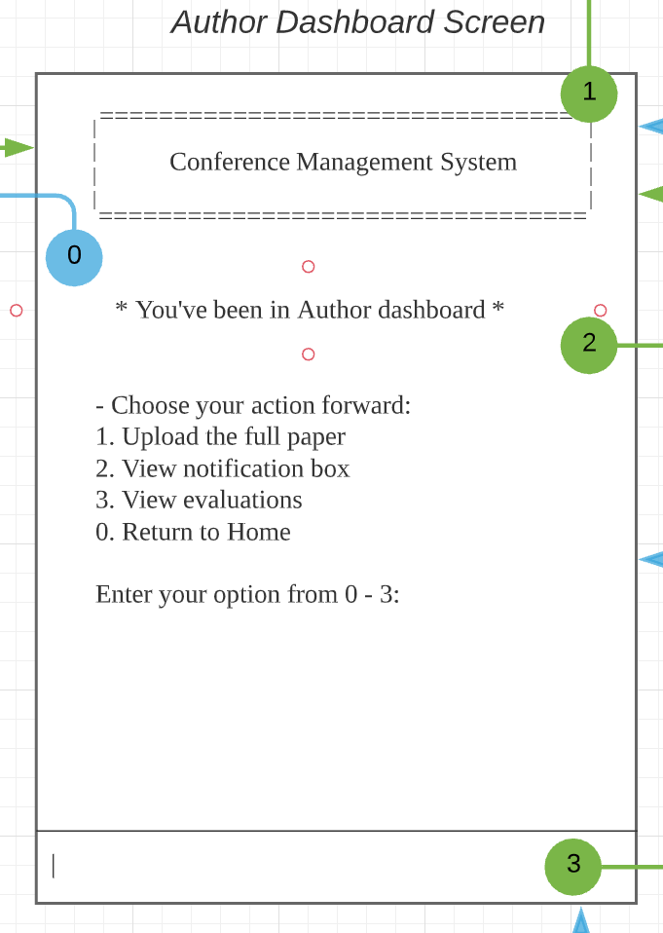
Usability Design Principles
7: Support internal locus of control
Internal control
Our users can easily control their actions by inputting these numbers.

Slide 18
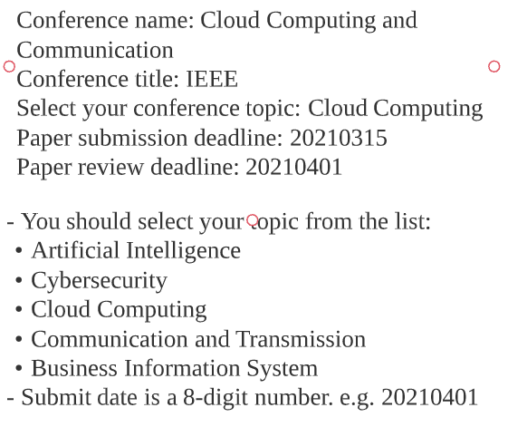
Usability Design Principles
8: Reduce short-term memory load
Reduce confusion
Since we are text-based design, we designed the date input to be an 8-digit number, so the users will not confuse about how to input the date.

Slide 19
Thank you for listening
Team 48

Slide 20
Q & A

